Slide 1

Linear Algebra in Computer Science
Unleashing the Power of Matrix
SAMAYUN MIAH CHOWDHURY
Software Developer

Slide 2
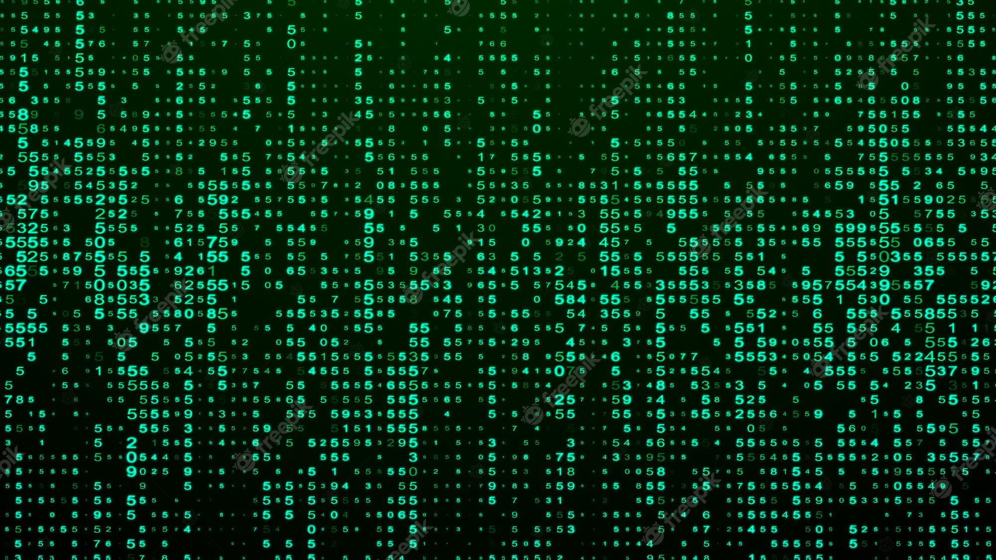

Unleashing the Power of Matrix
SAMAYUN MIAH CHOWDHURY
Software Developer

Slide 3
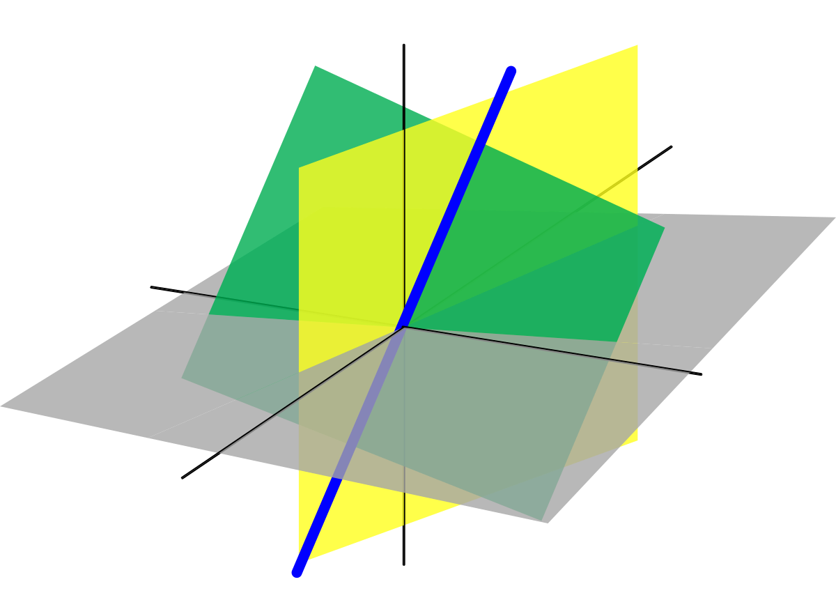
Introduction
Linear algebra, mathematical discipline that deals with vectors and matrices and, more generally, with vector spaces and linear transformations.

Slide 4
Foundations of Linear Algebra
Vectors: Vectors represent quantities with magnitude and direction. In computer science, vectors are often used to represent points in space, velocities, or other quantities. They can be represented as column or row matrices.
Matrices: Matrices are rectangular arrays of numbers. They are used to represent transformations, systems of linear equations, and various data structures. Matrices have dimensions defined by the number of rows and columns.
Basic Operations:
Addition and Subtraction:
Scalar Multiplication
Matrix Multiplication:
4. Matrix Properties:
Transpose * Inverse * Determinant: * Rank:

Slide 5
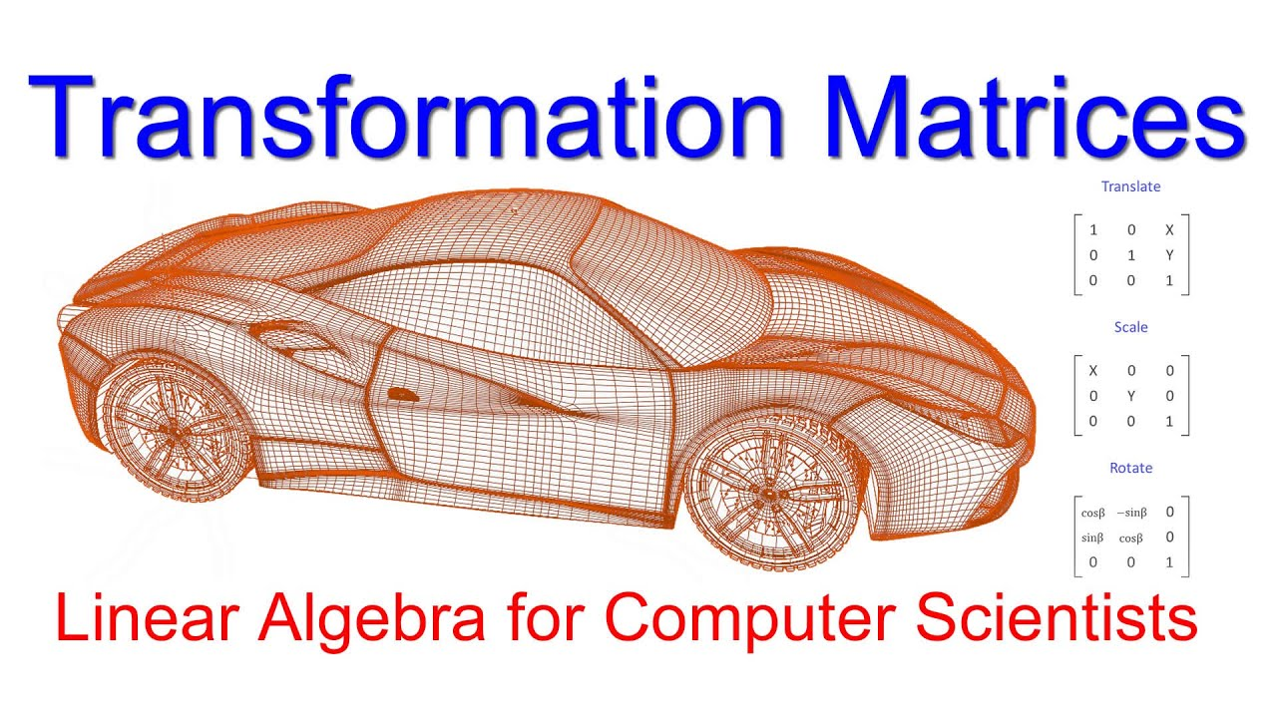
Applications of Linear Algebra in Computer Science
Computer graphics: 2D/3D transformations, rendering, and animation
Machine learning: feature extraction, dimensionality reduction, linear regression
Cryptography: encryption and decryption algorithms
Network analysis: graph theory and adjacency matrices

Slide 6
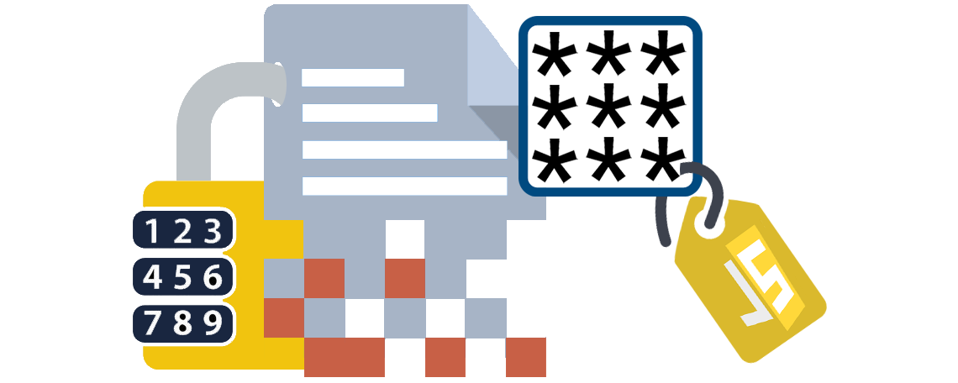
Cryptography - Blog Link Here
Symmetric and asymmetric encryption
Matrix operations in encryption and decryption algorithms
Key generation and secure communication

Slide 7
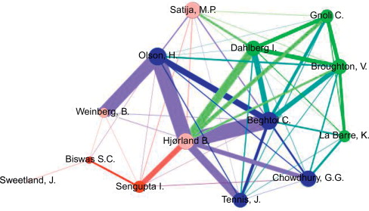
Network Analyis - Blog Link Here
Graph representation using matrices (adjacency matrix, incidence matrix)
Properties of graph matrices
Connectivity, shortest paths, and centrality measures
Social network analysis and recommendation systems

Slide 8
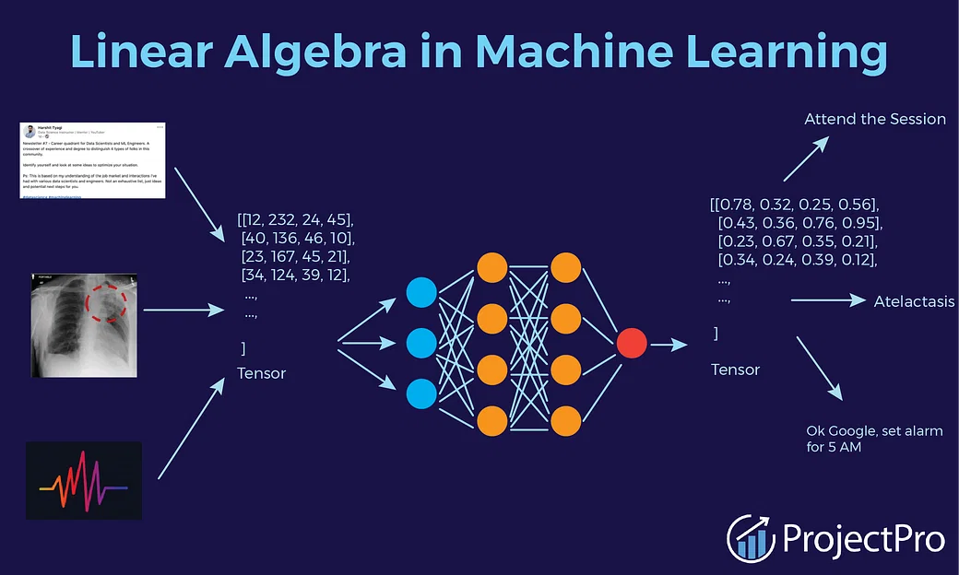
Performance Optimization
Efficient matrix computations using algorithms (Strassen's algorithm, LU decomposition)
Parallel computing and distributed systems
GPU acceleration for linear algebra operations
Examples of real-world performance g

Slide 9
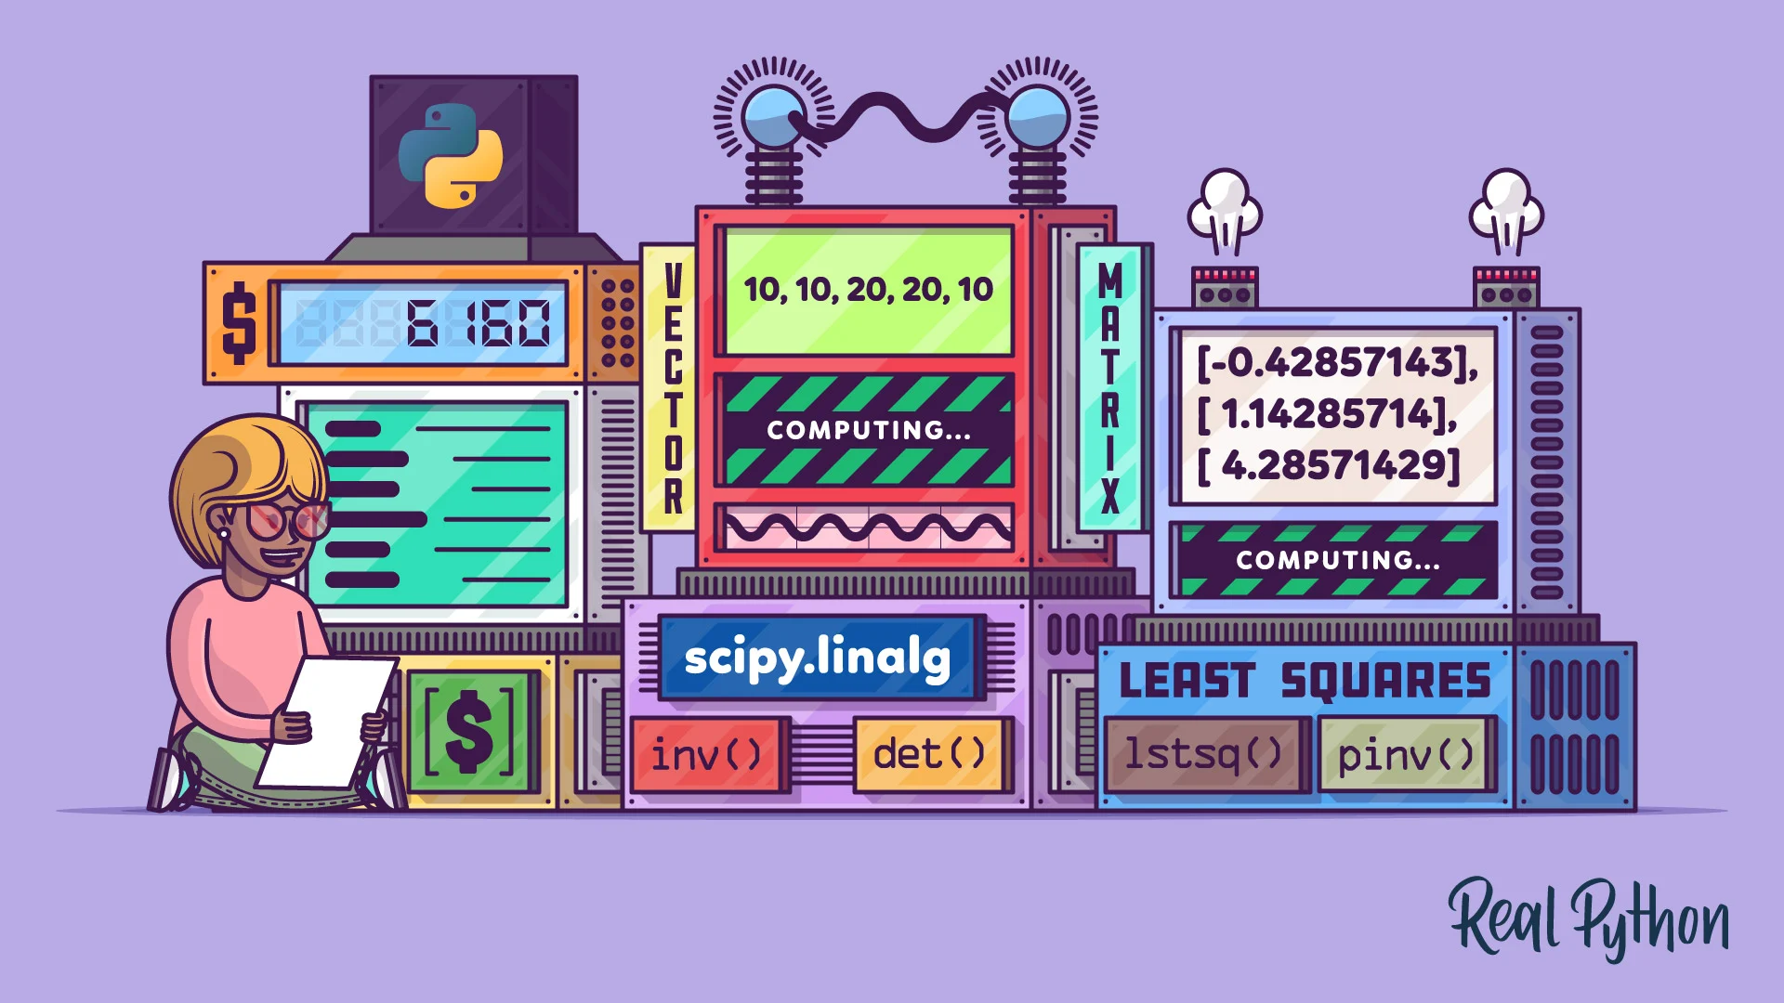
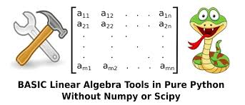
Libraries and Tools
Overview of popular linear algebra libraries (e.g., NumPy, SciPy, Eigen)
High-level programming languages with built-in linear algebra support (e.g., MATLAB, Python)
Visualization tools for matrices and vectors

Slide 10

Conclusion
Blog: Learn Linear Algebra with Python
Book: Practical Linear Algebra for Data Science

